Slide 1

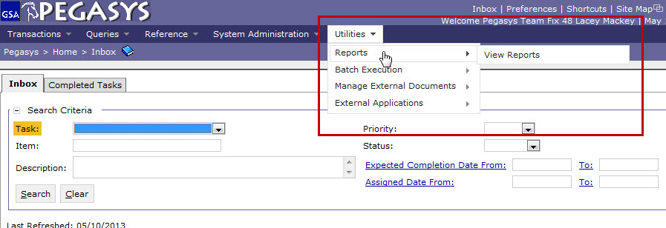
Generating Credit Card
Log Transaction Report
Click Utilities > Reports > View Reports

Slide 2
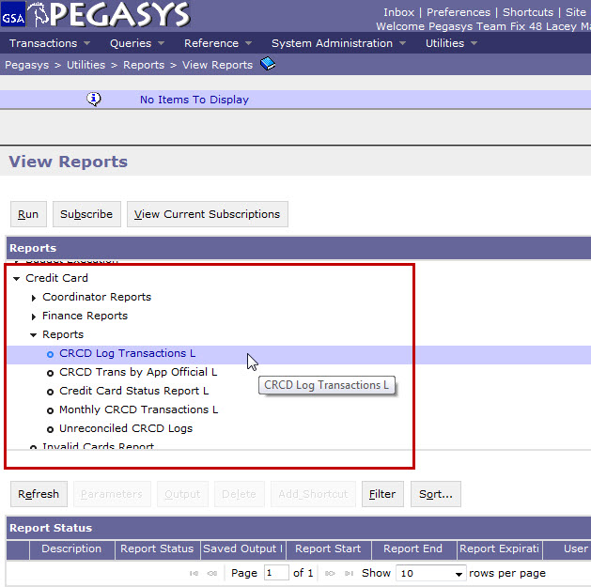
Generating Credit Card
Log Transaction Report
Click
Credit Card > Reports > CRCD Log Transactions L
Click Run

Slide 3
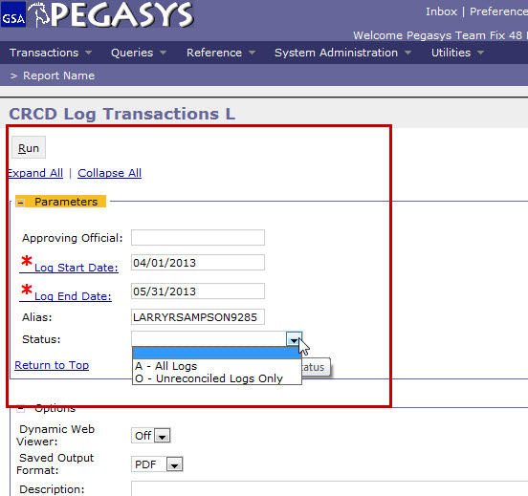
Generating Credit Card
Log Transaction Report
Enter Log Start Date and Log End Date
Enter Alias (case-sensitive)
Select Status
Click Run

Slide 4
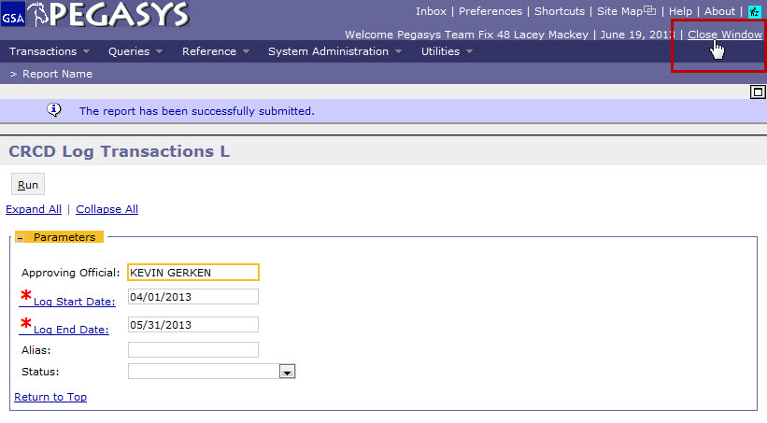
Generating Credit Card
Log Transaction Report
Click Close window
Note: The information message stating, “The report has been successfully submitted.” will appear at the top of the screen.

Slide 5
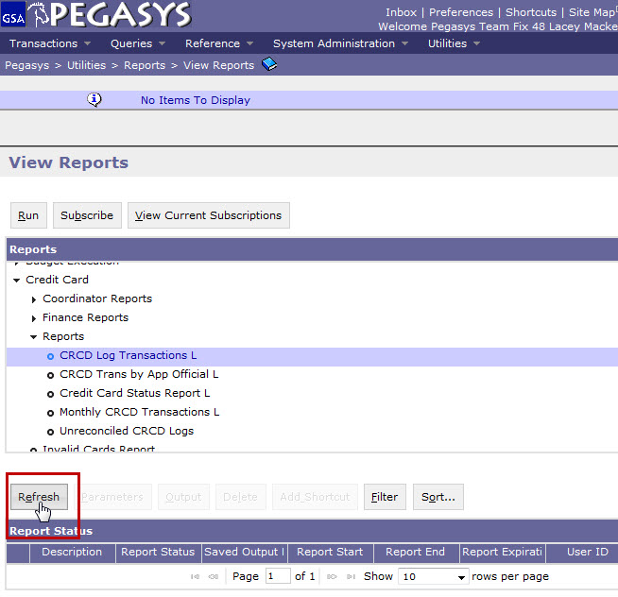
Generating Credit Card
Log Transaction Report
View original screen
Click Refresh

Slide 6
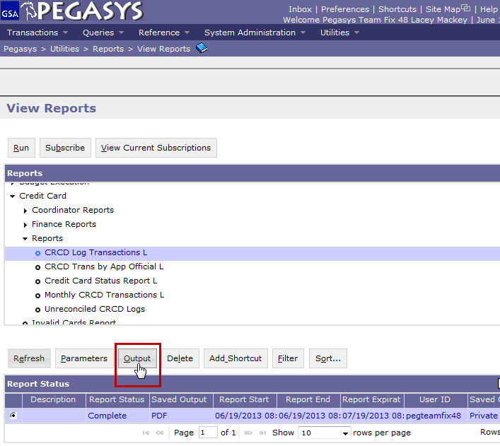
Generating Credit Card
Log Transaction Report
Click radio button to left of report
Click Output
Note: If your report is pending, wait a few minutes and click refresh again.

Slide 7
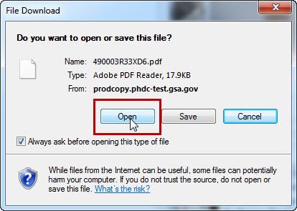
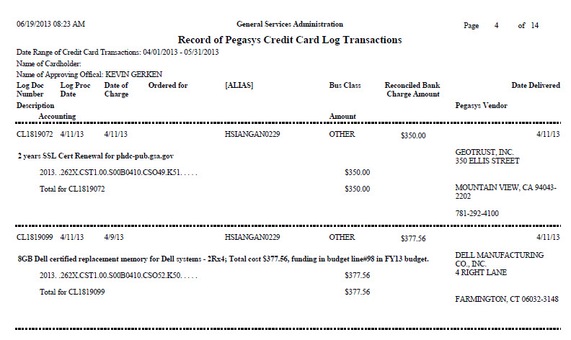
Generating Credit Card
Log Transaction Report
Click Open when File Download box appears

